Slide 1
Student Result Management System
Benjamin Nicolas S(221801005)
Charles Binny K(221801007)
Madhumitha G(221801030)

Slide 2
INTRODUCTION
In today's educational setting, the measurement of student performance is of utmost importance to educators and institutions. Traditionally, this has been done through manual processes, which are not only time-consuming but also prone to errors. However, the growing need to thoroughly analyze students' performances makes the development of automatic management systems imperative for improving the process and increasing the amount of data.
The Student Result Management System (SRMS) is a software solution designed to address this need. It is a system where academic management of records is made easy. It makes the process of collecting, analyzing, and processing student results convenient and easy for them. SRMS is the result of the automation of crucial tasks of grades and the computation of the results and report generation, which ultimately means the ensuring accuracy and saving time for the faculty.

Slide 3
EXISTING SYSTEM
Physical Records: There are still a few plants and institutions that use physical bound registers or logbooks as a storing mechanism for student information, attendance, and academic performance.
Basic Digital Tools: There are schools that have come to prefer digital technologies like spreadsheets (e.g., Microsoft Excel) or primitive database systems to the old ones in terms of managing academic records.
Result Compilation: The computations of the final score and overall average were made either manually or with basic formulas in the spreadsheets. It can slow down the learning process as well as increase the chances of mistakes, for instance in the case of large classes or multiple subjects

Slide 4
ADVANTAGES AND DISADVANTAGES
Minimal Financial Investment: The existing system typically involves minimal upfront costs, as it often relies on basic office supplies (e.g., registers, paper) or readily available software like Excel, which many institutions already have.
Simplicity: The existing system, especially when using physical records or simple spreadsheets, is straightforward and easy to implement without the need for complex software or IT infrastructure.
Accessibility Without Internet: Physical records and basic spreadsheets can be accessed and updated without an internet connection, making them usable even in areas with limited or unreliable internet access.
Human Error: The manual entry and calculation processes are prone to mistakes, such as incorrect data entry, miscalculations, or loss of records. These errors can impact the accuracy of student results and reports.
Vulnerability to Loss or Damage: Physical records are susceptible to being lost, stolen, or damaged (e.g., through fire, water, or wear and tear). Basic digital files are also vulnerable if not backed up properly.
Lack of Backup and Recovery: In the event of an accident or disaster, there may be no effective way to recover lost data, leading to permanent loss of important academic records.

Slide 5
PROPOSED SYSTEM
The proposed Student Result Management System (SRMS) is a comprehensive web-based solution that automates result processing and securely stores student data in a centralized database. It features an easy-to-use interface for administrators, faculty, and students, with role-based access control to ensure data privacy. The system provides real-time updates, instant notifications, and robust reporting tools, and integrates seamlessly with other college systems. Designed for scalability, the SRMS will improve efficiency, reduce errors, and enhance the overall management of student results.

Slide 6
ADVANTAGES OF PROPOSED SYSTEM
Increased Efficiency:
The system automates the result processing and report generation, significantly reducing the time and effort required by administrative staff.
Improved Accuracy:
Automated calculations and data entry minimize human errors, ensuring that student results are accurate and reliable.
Enhanced Data Security:
Role-based access control and encryption protect sensitive student data, ensuring only authorized users can access or modify records.

Slide 7
Real-Time Access and Updates:
Students, faculty, and administrators can access up-to-date results instantly, improving communication and transparency.
Scalability:
The system is designed to grow with the institution, easily handling increases in student numbers and academic programs without significant changes..
User-Friendly Interface:
The intuitive design ensures that all users, regardless of their technical skills, can easily navigate and use the system.

Slide 8
DISADVANTAGES OF PROPOSED SYSTEM
Initial Cost:
The development, implementation, and training for the new system can be costly, particularly for smaller institutions.
Technical Dependence:
The system requires regular maintenance, updates, and technical support, which could be a challenge for institutions without dedicated IT staff.
Learning Curve:
While user-friendly, there will still be a period of adjustment for staff and students as they learn to use the new system effectively.
Data Migration Challenges:
Transferring existing data from old systems to the new SRMS can be complex and time-consuming, with potential risks of data loss or corruption.

Slide 9
5.Internet Dependency:
As a web-based application, the system requires reliable internet access, which could be an issue in areas with poor connectivity.
6.Potential for System Downtime:
Like any digital system, there is a risk of technical failures or downtime, which could disrupt access to student results temporarily.
7.Security Risks:
Despite strong security measures, the system could still be vulnerable to cyberattacks, requiring constant vigilance and updates to security protocols.

Slide 10
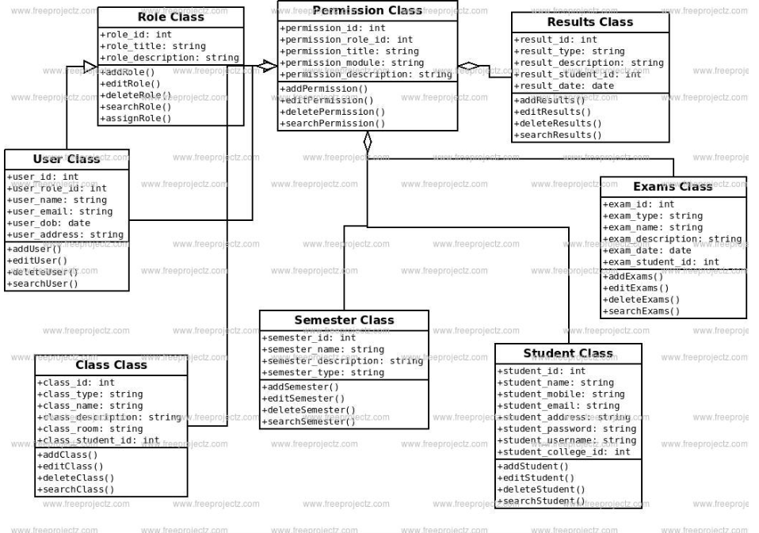
Class Diagram

Slide 11
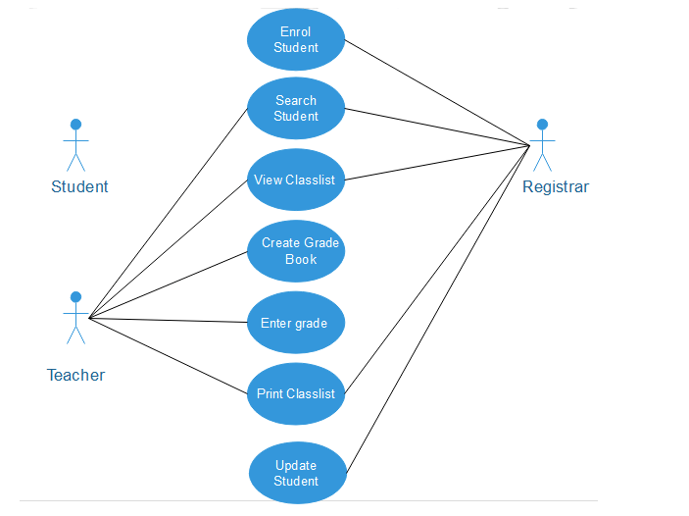
Use Case Diagram

Slide 12
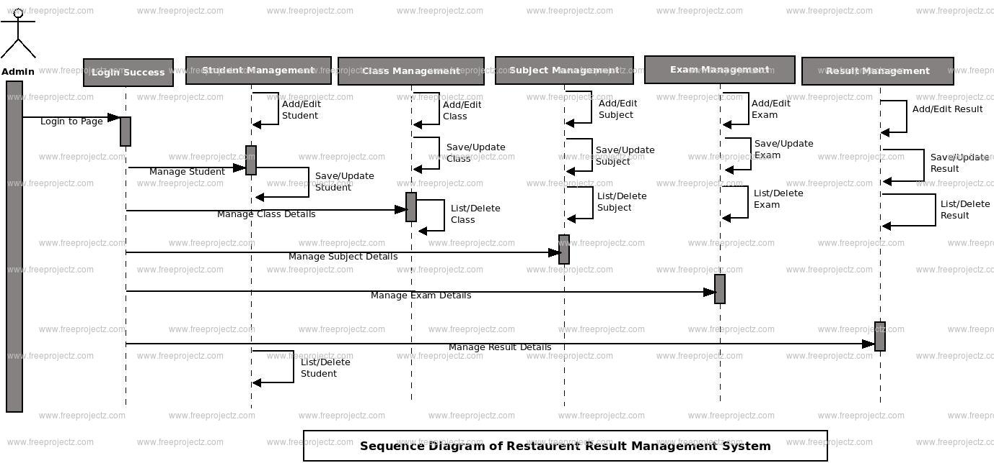

Slide 13
LITRATURE SURVEY
S.No | Author Name | Paper Title | Description | Jornal | Volume/ Year
01. | D. G. Patel and H. P. Modi, | "A Review on Student Result Management System", | Reviews advancements in digital student result management systems. | International Research Journal of Engineering and Technology (IRJET) | vol. 9, no. 7, pp. 2963-2966, July 2022.
02. | M. W. Bara, | "Advanced Automated Result Processing and Management System: (A Case Study of Mai Idris Alooma Polytechnic Geidam Yobe State)", | Discusses an automated result processing system at Mai Idris Alooma Polytechnic to enhance efficiency and result management. | International Journal of Advances in Engineering and Management (IJAEM) | vol. 3, no. 3, pp. 1384-1391, March 2021.

Slide 14
03 | M. Sami and N. A. Sharma | "Learning Computer Modules Using Multimedia and Social Media Platform in a Developing Country" | Explores multimedia and social media for teaching computer science in developing countries to boost engagement. | IEEE Asia-Pacific Conference on Computer Science and Data Engineering (CSDE) | 2021
04. | K. S. Kumar, K. Chandrakala, M. Manogna, M. Alekhya, T. Reshma and M. Arshiya, | "STUDENT RESULT MANAGEMENT SYSTEM Using Web Technologies", | Details a web-based student result management system using modern technologies for better accessibility. | Juni Khyat I (UGC Care Group I Listed Journal), | vol. 11, no. 1, pp. 476-480, 2021.
05. | N Winstone, J Bourne, E Medland et al | "Check the grade log out”: students' engagement with feedback in learning management systems[J]", | Examines student engagement with feedback in learning management systems to enhance outcomes. | Assessment & Evaluation in Higher Education, | vol. 46, no. 4, pp. 631-643, 2021.

Slide 15
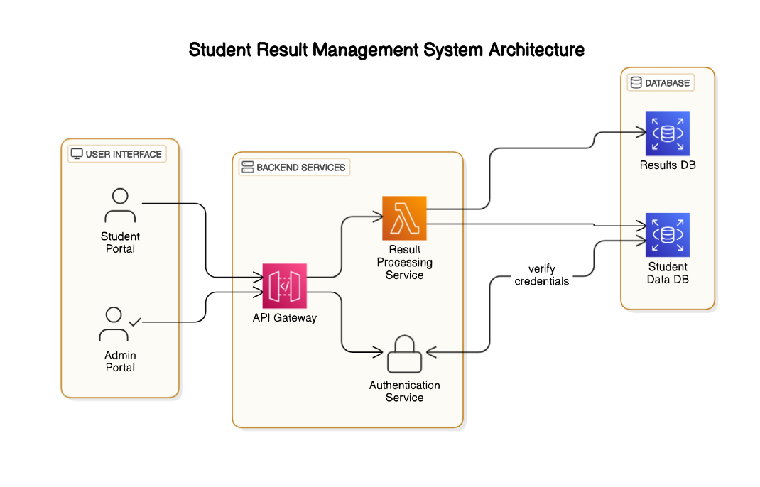
Architecture Diagram

Slide 16
LIST OF MODULES
ADMIN
USER
RESULT PROCESSING
RESULT DATABASE
STUDENT DATABASE

Slide 17
ADMIN MODULE
Resgister/login Module:-

The Home page of the “STUDENT RESULTS MANAGEMENT
SYSTEM”.

It consists of Two portal about student and admin..

Login page is used to login to the admin portal.
2.Student Module:

students can view the results.

student can download the results..

Slide 18
STUDENT MODULE
2.Student Module:

students can view the results. 
student can download the results

Slide 19
Admin Module:
Admin Module:

Create and manage the subjects , classes and can add the students
and their results of the students.

Reports for various modules
Update or deleting the admin information

Slide 20
ADMIN MODULE
Provides secure access for administrators to manage student data, results, and notices.
Allows updating of individual student results, adding new entries, and correcting stored data.
Enables management of the student database, including personal information and login credentials.
Facilitates posting notices to keep students informed on academic updates and announcements.
Ensures data integrity, efficient communication, and transparency within the system.

Slide 21
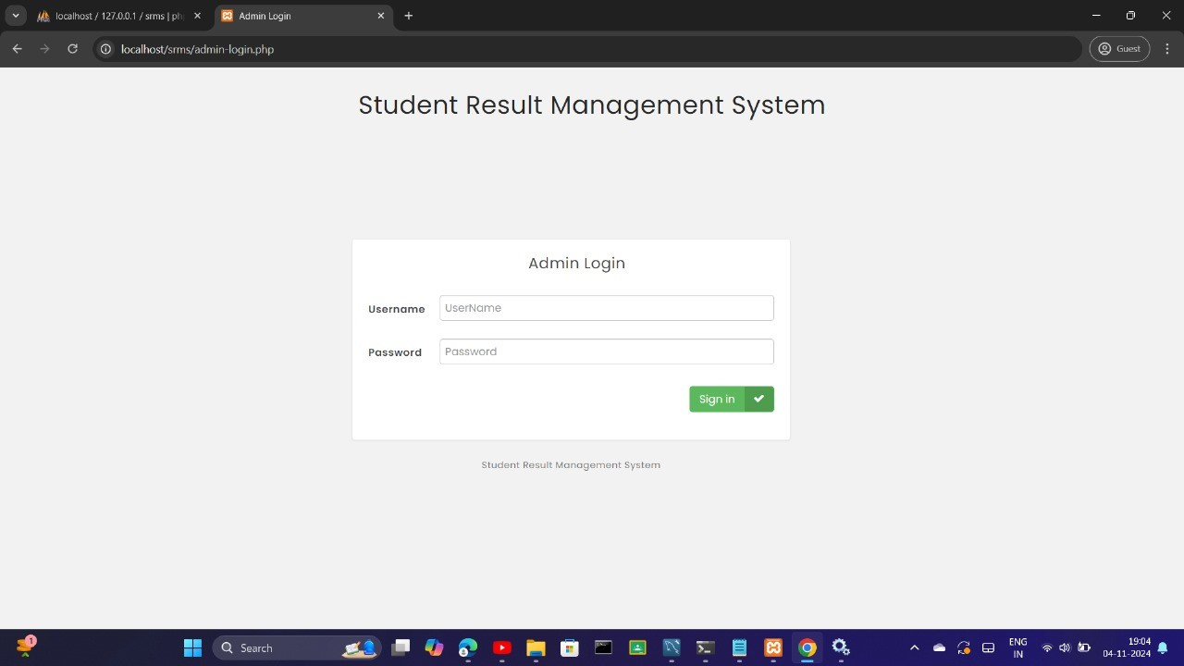
ADMIN MODULE

Slide 22
USER MODULE
Secure portal access with verified credentials for data privacy.
Personalized dashboard for real-time viewing of grades and academic records.
Instant access to grades and records from the Results Database.
Notices section for important updates like result release dates.
User-friendly, accessible, and secure platform for academic progress tracking.

Slide 23
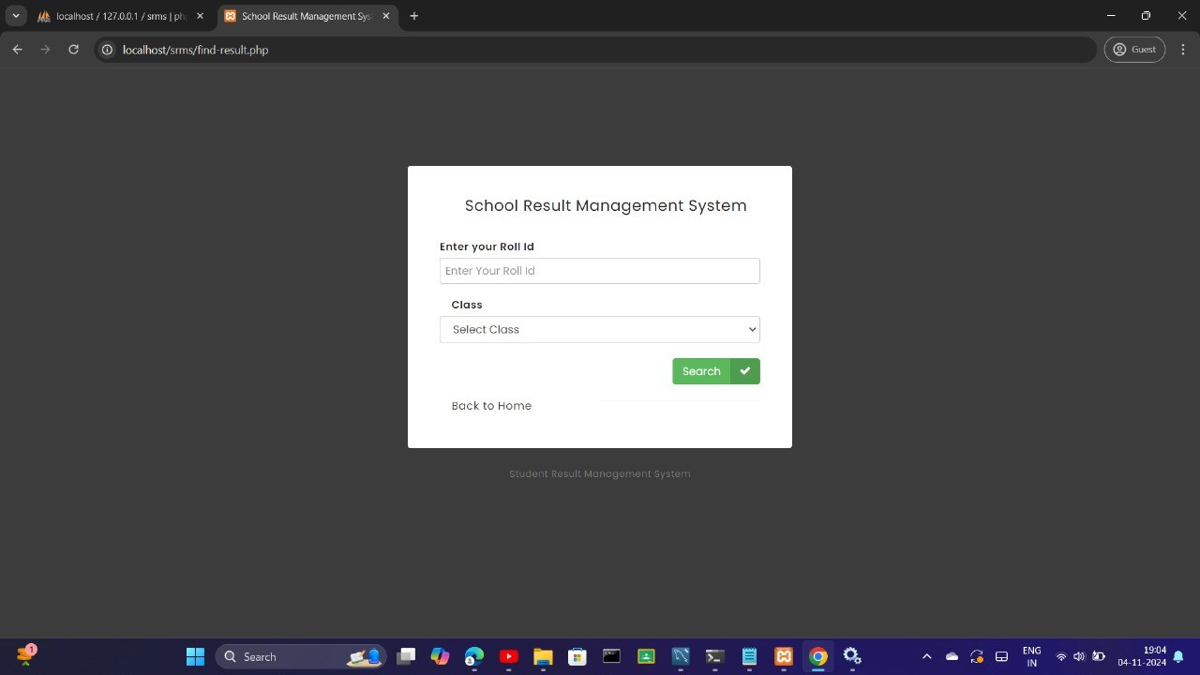
USER MODULE

Slide 24
RESULT MODULE
Serves as the core processing unit for handling all student result operations.
Acts as an intermediary between the student and admin portals and the Results Database.
Retrieves, processes, and displays student results in an organized format for real-time viewing.
Allows administrators to add, edit, or delete result entries, ensuring data accuracy and currency.
Maintains integrity and accessibility of academic records for both students and administrators.

Slide 25
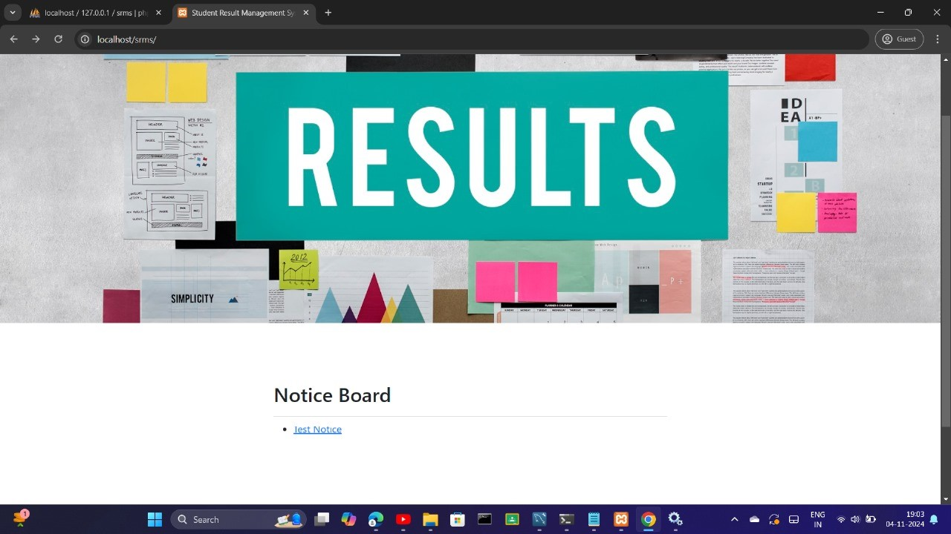
USER MODULE

Slide 26
NOTICE MODULE
Facilitates communication between administration and students.
Allows administrators to create, edit, or delete notices via the Admin Portal.
Notices are stored in the system database and accessible on the Student Portal.
Enables students to receive updates on exams, results, re-evaluation, and policy changes.
Ensures timely display of new or modified notices for prompt student awareness.
Enhances communication flow, helping students stay informed and take timely action based on announcements.

Slide 27
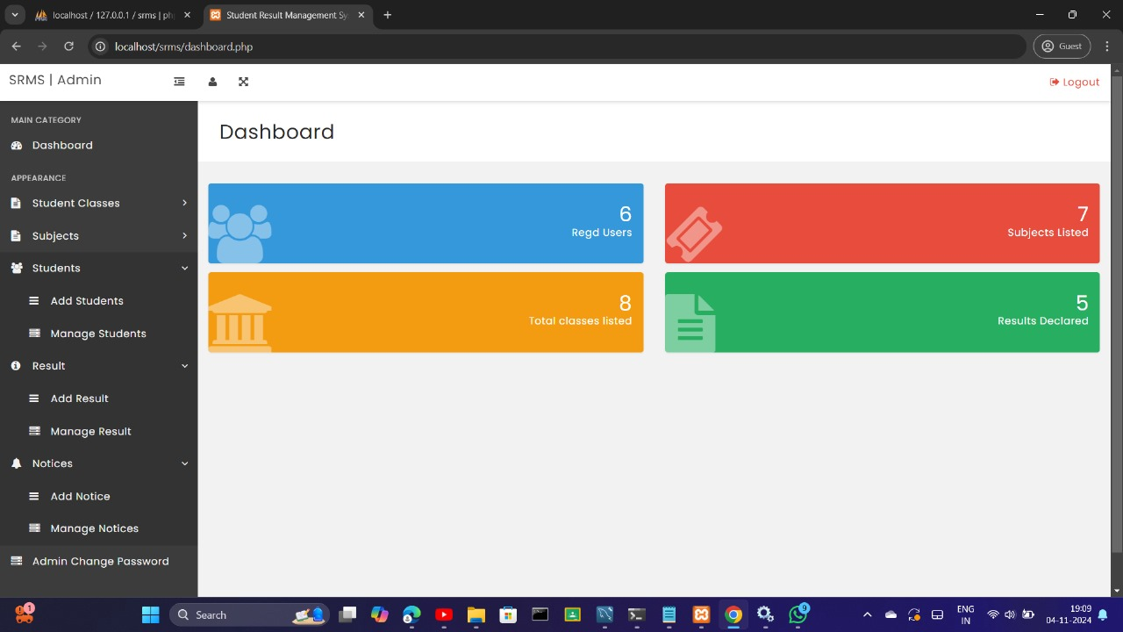

Slide 28
DATABASE MODULE
Serves as the backbone of the Student Result Management System by storing and organizing essential data.
Comprises two main databases: Results Database and Student Data Database.
Results Database stores academic records, grades, and related data.
Enables quick grade access for students and efficient updates for administrators.
Student Data Database holds personal information, authentication credentials, and non-academic data.
Supports the authentication process by verifying user credentials.

Slide 29
TESTING
Data Entry and Storage : Verify accurate storage of student details and results in the database from the frontend.
Result Calculation and Display : Ensure correct integration between score calculation (PHP) and display (JavaScript/jQuery).
Database Retrieval for Reports : Test the retrieval of data from MySQL for consistent and accurate report generation.
User Authentication : Confirm secure login and access to student-specific results.
Data Consistency Across Modules : Validate data consistency between the input form, database, and displayed results.
Error Handling : Check for proper error messages and alerts on failed data processing or retrieval.
Edge Case Testing : Test with unusual data entries to verify stability and robustness.

Slide 30
TESTING
Slide 1: Integration Testing Overview**
- **Purpose**: Validate interactions among modules in the student result management system, ensuring smooth data flow.
- **Scope**: Test data entry, result calculation, storage, and report generation across PHP, jQuery, JavaScript, and MySQL.
Slide 2: Key Test Scenarios
1. Data Entry & Storage
- *Objective*: Confirm front-end data saves accurately in MySQL.
- *Steps*: Input sample data, submit, verify in database.
2. **Result Calculation & Display**
- *Objective*: Check PHP logic displays correctly via JavaScript/jQuery.
- *Steps*: Input scores, calculate, verify display.
3. **Data Retrieval & Report Generation**
- *Objective*: Ensure MySQL data retrieves correctly for reports.
- *Steps*: Retrieve data, verify consistency.

Slide 31
Slide 3: Testing Process
- **Test Data**: Sample grades, edge cases (e.g., empty fields).
- **Methodology**:
- *Top-Down*: Start with calculations to storage.
- *Incremental*: Test module pairs step-by-step.
- **Validation**: Confirm data consistency, error handling, and report accuracy.
Slide 4: Results Summary**
- **Successes**:
- Data flows between PHP, MySQL, and UI correctly.
- **Issues**:
- Fix format inconsistencies, improve error handling.
- **Next Steps**: Refine data handling and enhance modular testing for scalability

Slide 32
WATERFALL MODEL

Slide 33
Overview with waterfall model
The Waterfall Model is a linear, sequential approach to project development. Each phase must be completed before moving on to the next, making it suitable for projects with clear requirements. Here’s how each stage applies to the Student Result Management project.
1. Requirements Analysis
- *Goal*: Gather and define system requirements, like student data input, result calculation, and report generation.
- *Outcome*: A requirements document outlining functional needs (e.g., data entry forms, report formats) and technology stack (PHP, MySQL, JavaScript, jQuery).
2. System Design:
- *Goal*: Design the architecture, including database schema in MySQL and the UI layout.
- *Outcome*: Database tables for student records, grade calculations, and web interface wireframes for data entry and report viewing.

Slide 34
3. **Implementation**
- *Goal*: Develop the system components:
- **Frontend**: HTML, CSS, JavaScript/jQuery for user interface.
- **Backend**: PHP for logic and MySQL for data storage.
- *Outcome*: A functional application where student data is entered, stored, and processed.

Slide 35
4. Integration & Testing:
- *Goal*: Conduct integration testing to verify that all modules (e.g., data entry, calculation, reporting) work together smoothly.
- *Outcome*: A stable, tested system with accurate data processing and reliable outputs.
5. Deployment
- *Goal*: Deploy the system to a live server or educational institution’s network.
- *Outcome*: The system is ready for use, allowing faculty and administrators to manage student results.
6. Maintenance
- *Goal*: Regular updates and fixes to ensure the system functions effectively.
- *Outcome*: A sustainable system with periodic maintenance checks.

Slide 36
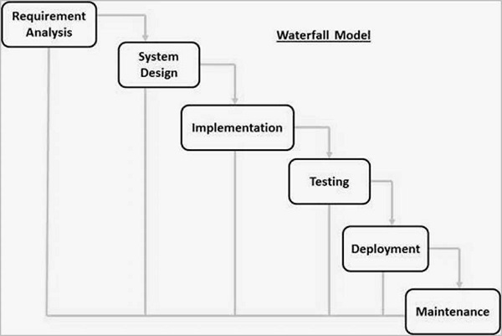
WATERFALL MODEL

Slide 37
RESULT
The **Student Result Management System** is an integrated platform designed to streamline the management and access of student academic information. It includes key modules: the **User Module** for secure student login, grade viewing, and notice access; the **Admin Module** for administrators to manage data, post notices, and update academic records; the **Result Module** for real-time result access and record updates; the **Notice Module** for announcements; and the **Database Module** to securely store all student data and records. Together, these modules ensure efficient data handling, promote effective communication, and provide secure, accurate information access, enhancing the academic experience for students and administrators alike.

Slide 38
CONCLUSION
In conclusion, the “Students Result Management System” developed with PHP, jQuery, JavaScript, and MySQL** successfully streamlines the management of student results. PHP handles dynamic requests and data processing, while MySQL ensures efficient storage and retrieval of student records. JavaScript and jQuery enhance front-end interactivity, providing an intuitive and responsive user experience. Key features include adding, updating, and deleting records, generating reports, and secure access for students and administrators. This system reduces administrative workload and improves accuracy, making result management more accessible and efficient for educational institutions, with potential for future enhancements.

Slide 39
REFERENCE
M. W. Bara, "Advanced Automated Result Processing and Management System: (A Case Study of Mai Idris Alooma Polytechnic Geidam Yobe State)", International Journal of Advances in Engineering and Management (IJAEM), vol. 3, no. 3, pp. 1384-1391, March 2021.
D. G. Patel and H. P. Modi, "A Review on Student Result Management System", International Research Journal of Engineering and Technology (IRJET), vol. 9, no. 7, pp. 2963-2966, July 2022.
M. Sami and N. A. Sharma, "Learning Computer Modules Using Multimedia and Social Media Platform in a Developing Country", IEEE Asia-Pacific Conference on Computer Science and Data Engineering (CSDE), 2021.
K. S. Kumar, K. Chandrakala, M. Manogna, M. Alekhya, T. Reshma and M. Arshiya, "STUDENT RESULT MANAGEMENT SYSTEM Using Web Technologies", Juni Khyat I (UGC Care Group I Listed Journal), vol. 11, no. 1, pp. 476-480, 2021.
N Winstone, J Bourne, E Medland et al., "Check the grade log out”: students' engagement with feedback in learning management systems[J]", Assessment & Evaluation in Higher Education, vol. 46, no. 4, pp. 631-643, 2021.

